Slide 1
PLANNING SLIDE
Player
Role at the table (Player vs DM)
DM
Job of the DM
Running a Game
Session Zero
Worldbuilding
Online Play
Phases of Play (Action/Bonus/Movement)
Play Style
Melee/Range/Caster/Support
Game Style (Gritty Realism, Sarcasm, Humor, Heavy Combat, Political, Urban)
Party Play vs Person Play
Before the Table - How should it go
After the Table - How did it actually go
Know your game - not just the monsters - but the players too
At the Table - How is it going
House Rules
Setting the stage
Moving the action
Start simple
Start Simple
Start Small
Start with what you know
Make it possible
Resources
Hooks
Referee
Narrator
Memory
D&D Beyond
Kobold Fight Club
Roll20
Token Maker
Google Images
Lost Atlas lostatlas.co

Slide 2




Learn to Play D&D
Friday
Learn to be a Dungeon Master
Saturday
Worldbuilding for D&D
Saturday
Running the Game and Campaign
Sunday
Using Online Tools to Play D&D
Sunday
7:30pm
11:30 am
1:30 pm
12:30 pm
2:30 pm
https://github.com/majornerd/dragonfodder
Notes:
https://github.com/majornerd/dragonfodder

Slide 3
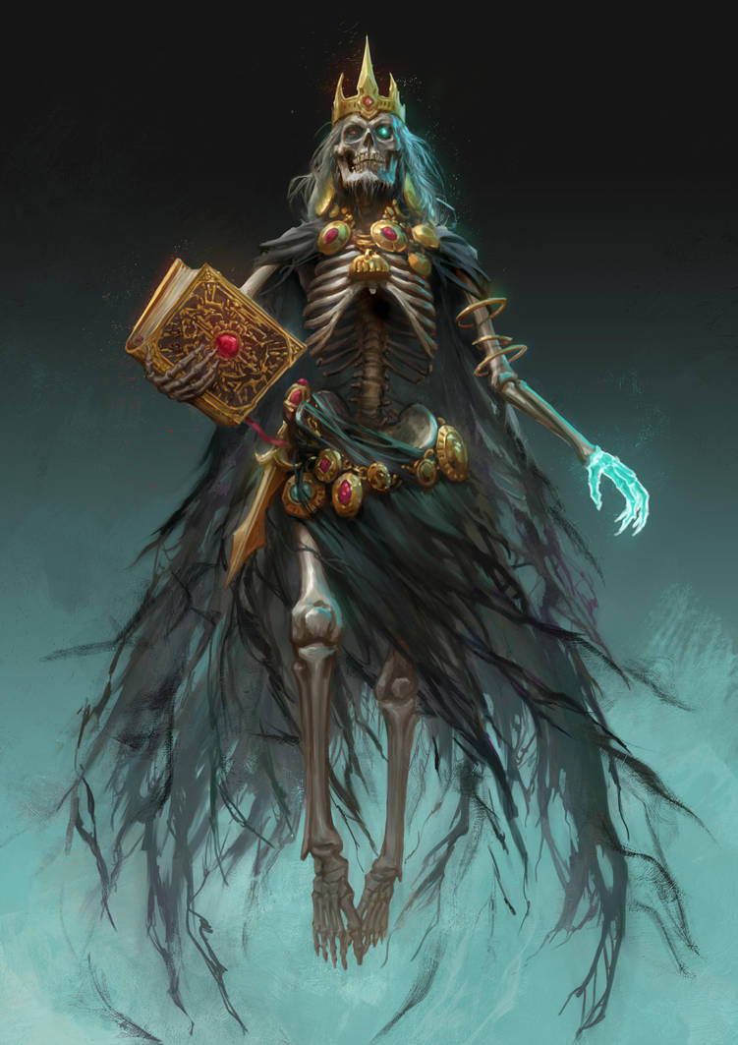
Welcome to Dragon Fodder
We will start from zero, no experience required
Participation will be rewarded
We have gifts
Targeted for Beginners, enough content that experts should have a take away or two

Slide 4
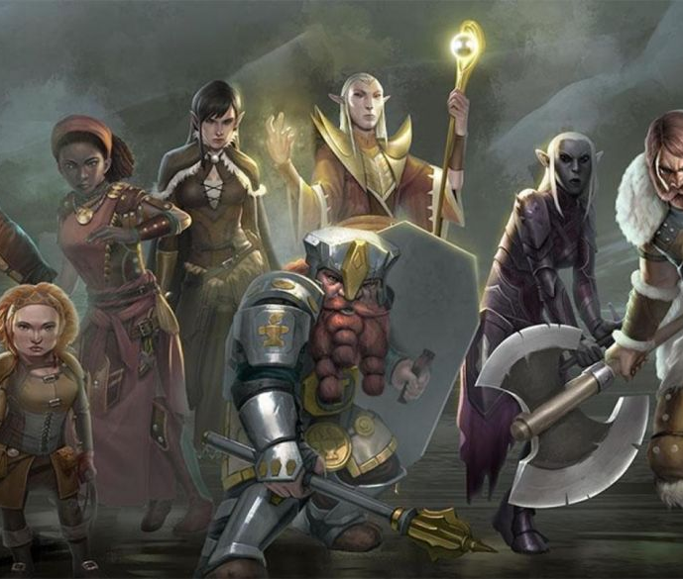
Who is Dragon Fodder?
Howard – DM – 35yrs (DM for 35yrs)
Darrel – DM – 45 yrs (DM for 5)
Jennifer – Player – 5 years of Play (4e & 5e)
Scott – Player & Pro Presenter – 3 years of Play
Chadd – Player – 1.5 years of play
In Absentia
Tom – Rogue and Paladin
Guy – Cleric and Fighter
Kate – Generally just Evil
Austin – Fighter in Seattle
Delzer – Barbarian in DFW

Slide 5
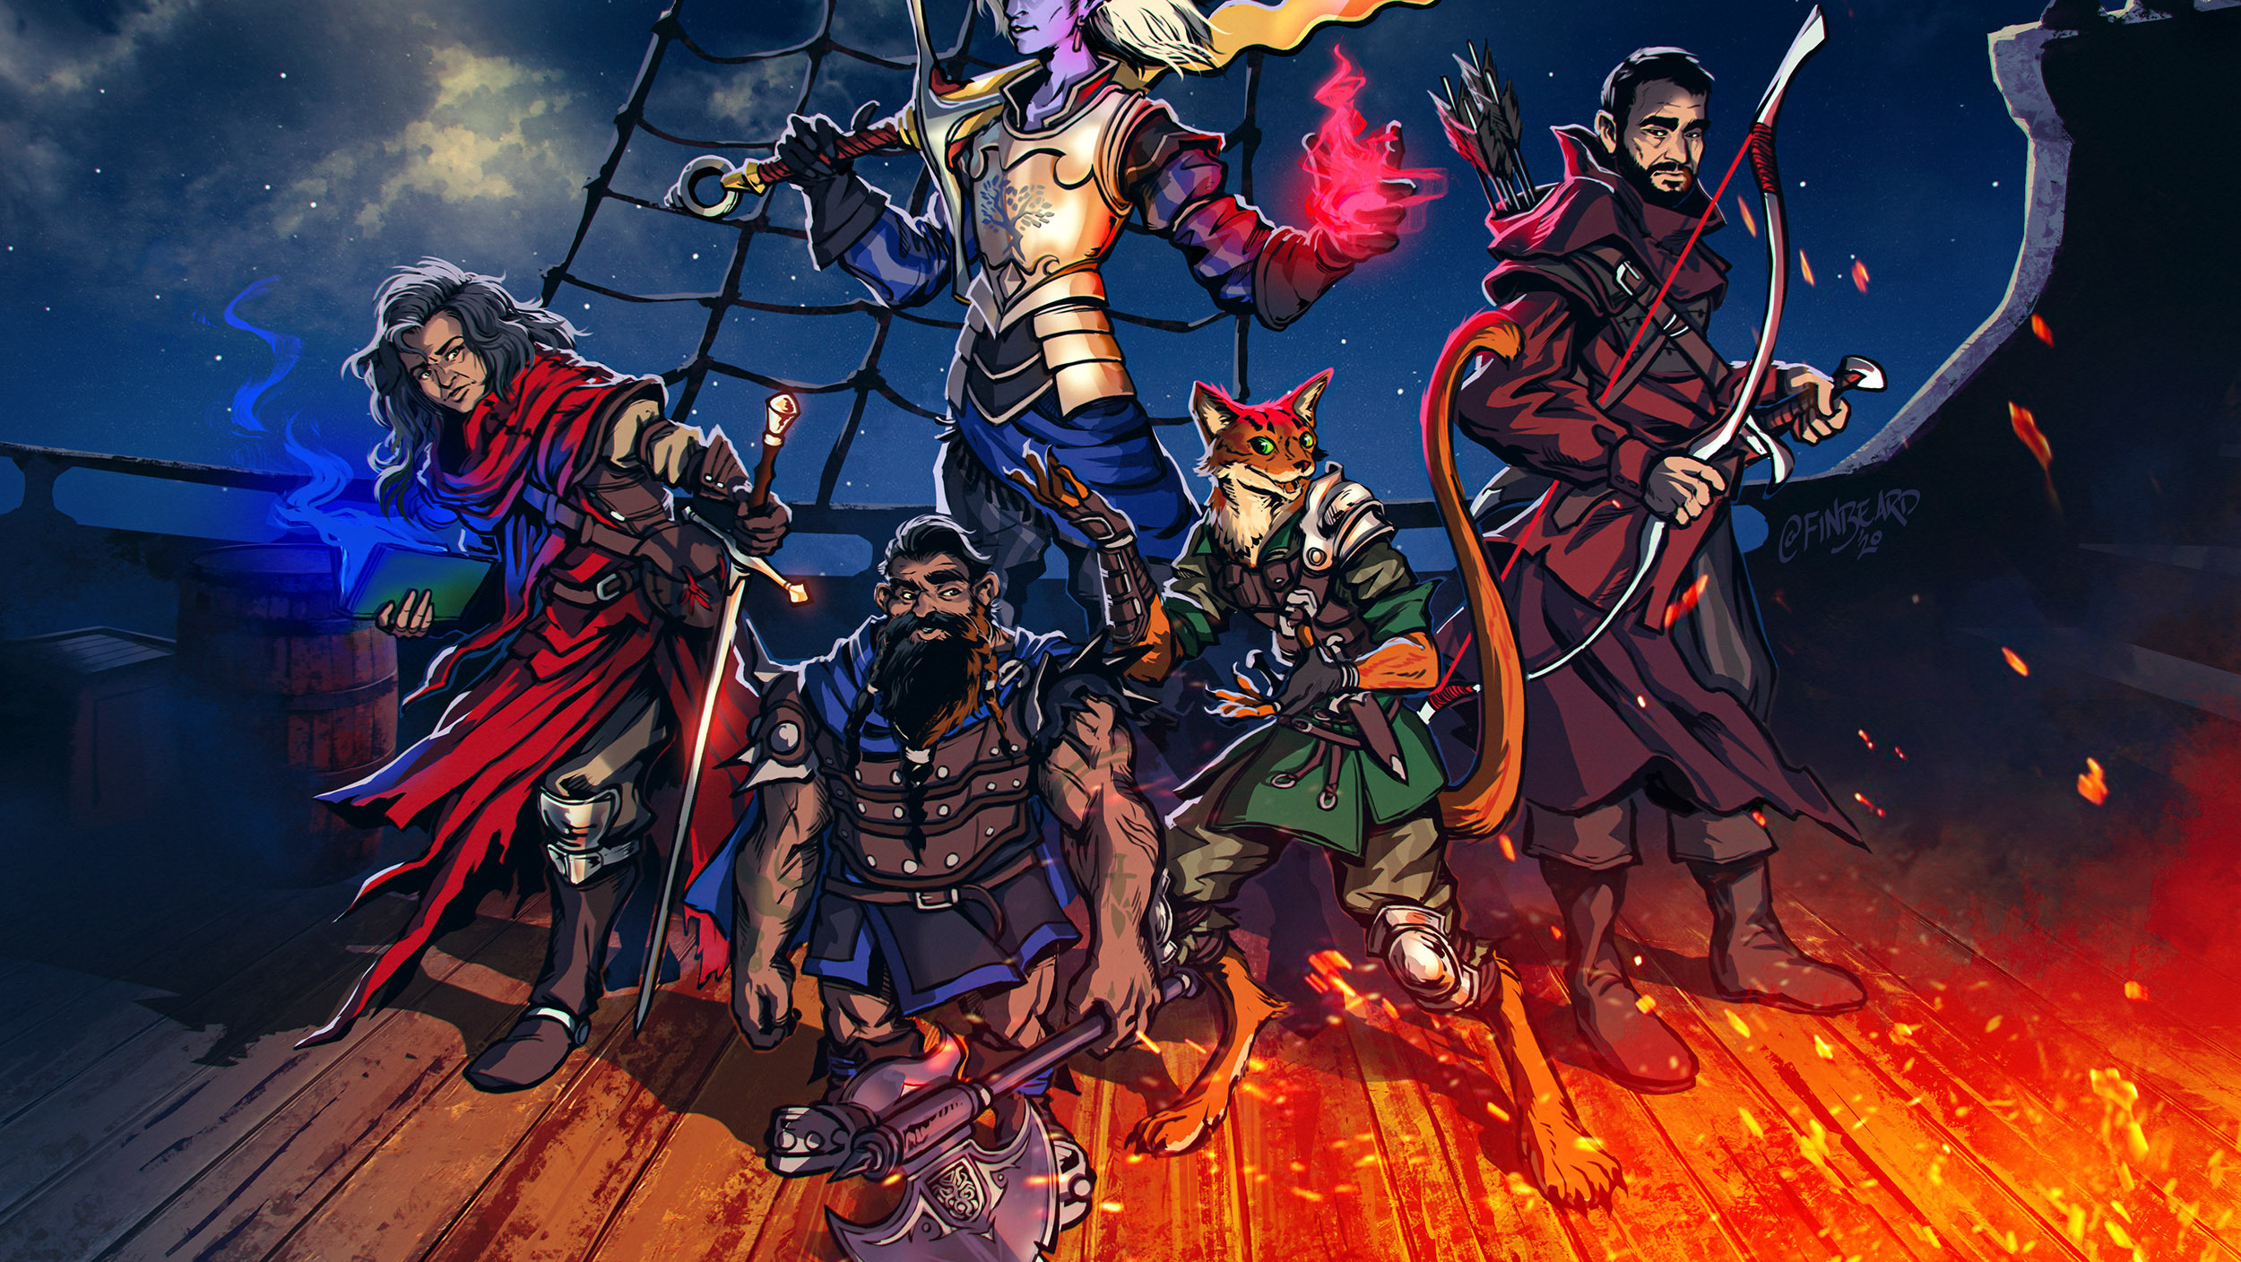
It’s PARTY play, NOT "person" play

Slide 6
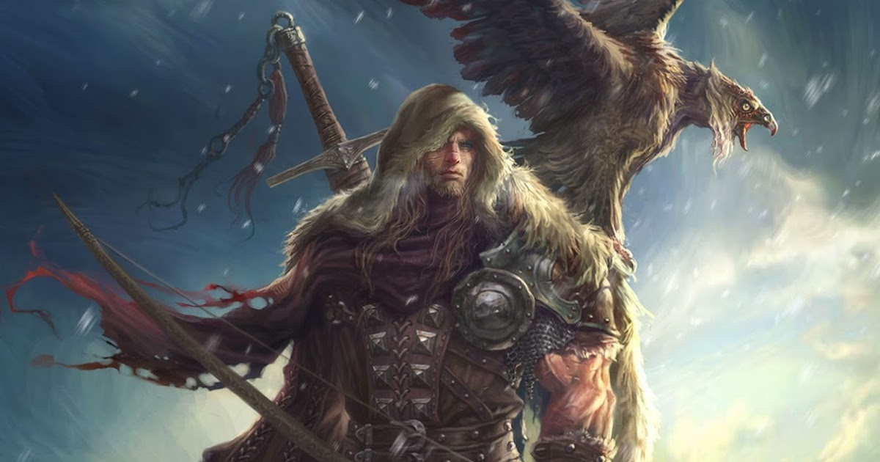
Dungeons and Dragons is a game of communal storytelling

Slide 7
Character Creation
20 questions
What do you look like
How do strangers see you
What was your upbringing
Are you still in contact with people from your childhood
Why did you become an adventurer
Where have you been already
Do you believe in the Gods? Do you follow one?
How do you feel about Magic?
What is worth dying for?
20Q Cont’d
What is your dream?
What is your stance on morals or the law
How do you deal with strangers?
How do you place a value on a person's life? Animals?
Do you see all races as the same?
Does your hero like arts?
What’s your favorite meal?
What about love?
Do you have a dark secret?

Slide 8
Running a Game

Slide 9
Session Zero

Slide 10
House Rules

Slide 11
Setting the stage

Slide 12
Moving the action

Slide 13
Start simple

Slide 14
Hooks

Slide 15
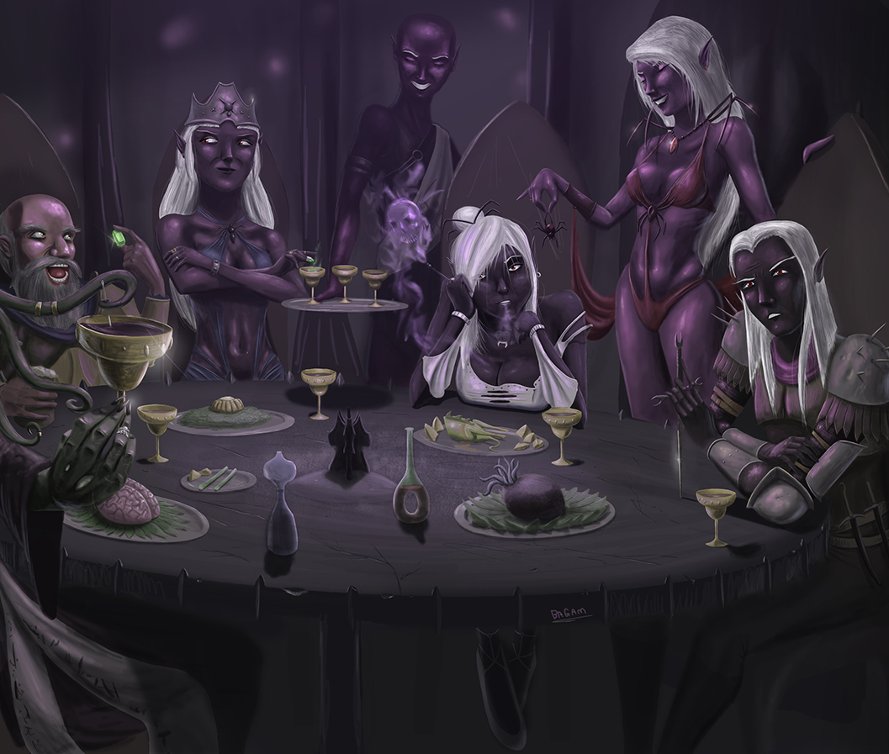
Running the Game
Relax
Focus on your Strong Start
Listen to the players and build off what they bring
Trust your preparation to help you run a creative AND flexible game
Ask the players to summarize the prior session
Draw players into the story by asking them to describe the action; reward them when they do, do NOT penalize them when they don’t
Imagine the world as a living place
The players drive the action, make the world react to them, not the other way around
Use a mixture of combat styles, including theater of the mind, gridded maps, and abstract maps
Maintain a good pace by keeping the action close
Story cycles are crirical, so balance action with relaxation building and releasing tension.
The dice build tension, use them accordingly
Use specific hopeful and fearful beats to send the action in a specific direction
Sometimes a chair is just a chair, but never if the DM says it is a chair

Slide 16
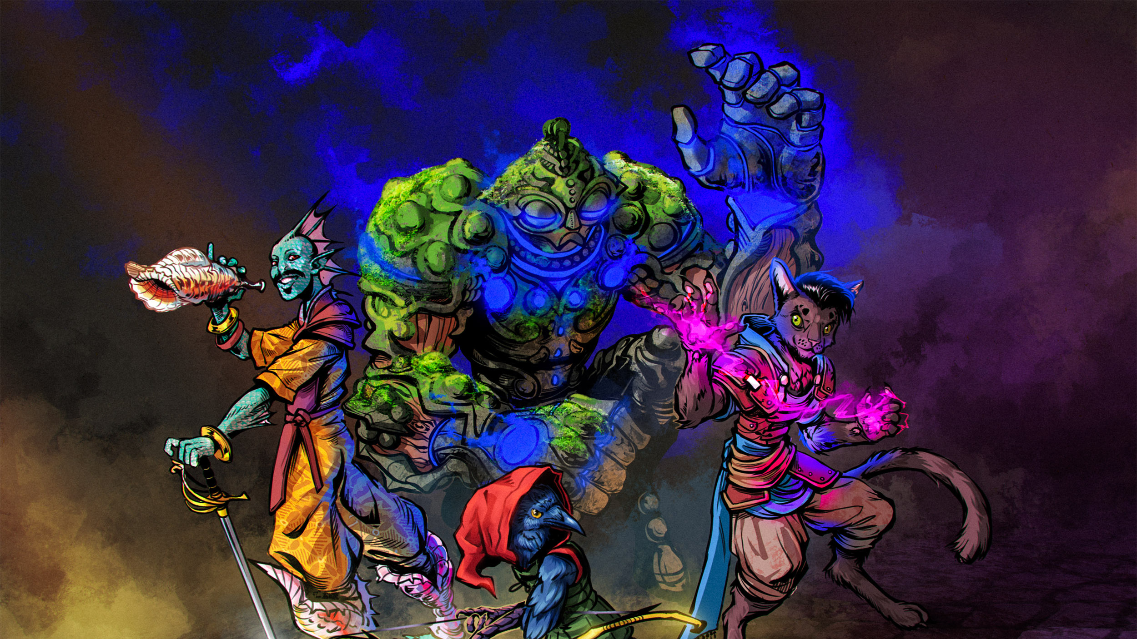
Building the Campaign
Reskin Published Material
Develop a Spiral Campaign with the Players at the Center
Hook based on a single major goal
State the Six Truths of your Campaign
Define Three Fronts Incorporating goals and grim portents
Run a Session Zero to help build the characters and tie them together
This Photo by Unknown Author is licensed under CC BY-NC-ND

Slide 17
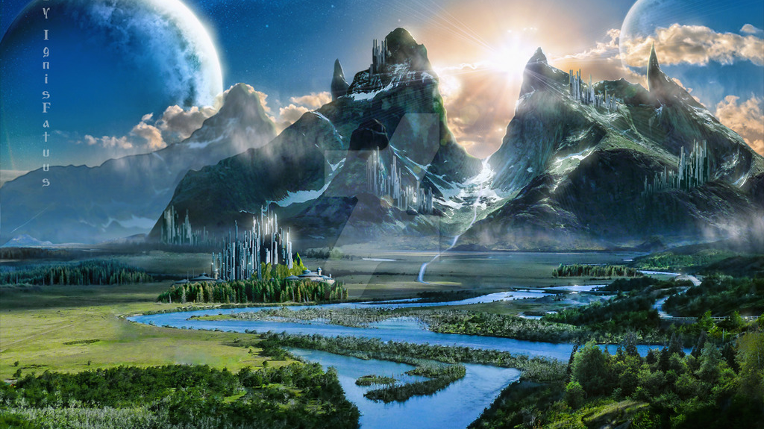
Worldbuilding

Slide 18
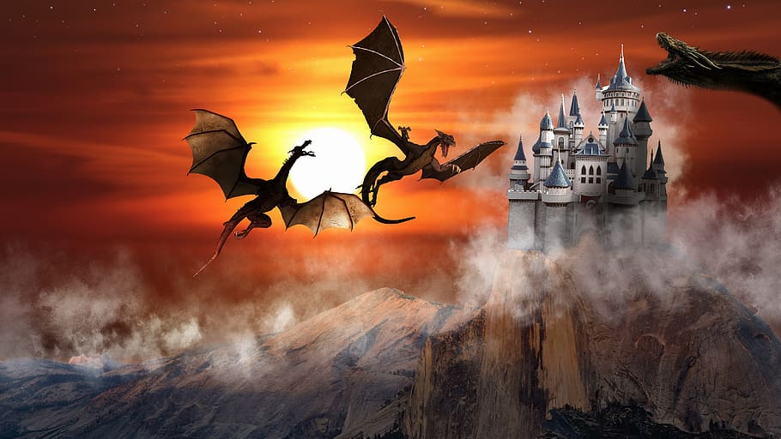
Coherency, Consistency, Verisimilitude

Slide 19
Liminality - describe the psychological process of transitioning across boundaries and borders
The goal is to break the barrier to make your world feel real.
Not that it is real, but that it COULD be
Coherent and Consistent
It must have the same drivers that this world does
It must be consistent, even when it is not

Slide 20
What drives the real world?
Drivers of Reality:
People
Economy
Weather & Ecology
Freedom and Agency
Power

Slide 21
What is missing?
Technology and Magic are not drivers of the real world (or fake world in the case of Magic)

Slide 22
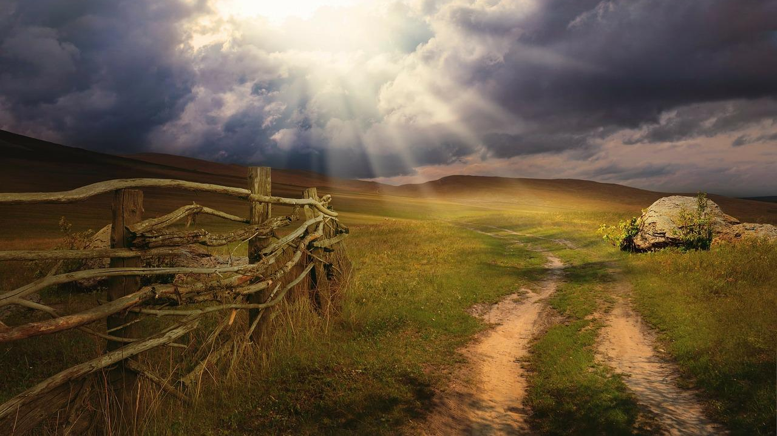
Start Simple
Describe what you see – that’s what your players will see

Slide 23
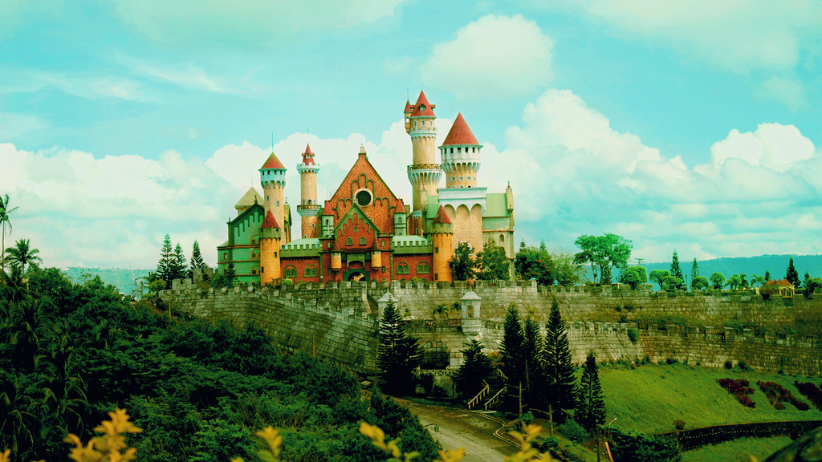
Start with what you know

Slide 24
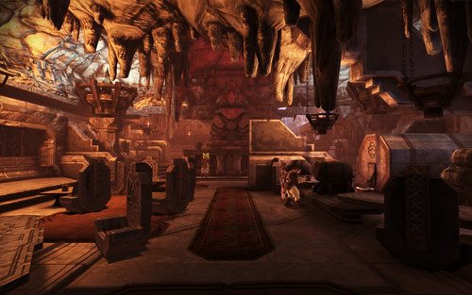
Start Small
Start with why, why is interesting
Why are adventurers needed?
Who runs things
What happened 200 years ago
Is this a successful empire, or is there a lost king/kingdom

Slide 25

Make it plausible

Slide 26
People
How do people congregate?
Look to history
Population density is a huge factor in low-tech nations (exchange magic for tech)
Up to about 1500 AD the highest density population in any European nation was about 100 people per sq mile. London, Rome, Paris, Berlin, etc…. 100ppl
It requires a tremendous amount of land to raise cattle and farm in pre-industrial world to feed people
Clean water was a valuable resource. No clean water = no people
Hand digging a well changes where you can live and prosper
Large changes in population
Decreases happened frequently – famine, harsh weather, plague, war all drove population down
Increases were nearly unheard of, except in the case of massive migrations

Slide 27
Travel
Most people TODAY do not live more than 50 miles from where they are born
In pre-industrial times it was closer to 5
Travel was rare for the “working class”, expensive, and took a long time
Horses do not travel much further in a day than humans, not if you want them to survive

Slide 28
Economy
How is wealth created?
Look to history
How has magic changed the economy?
Has it always existed?
Is it a limited resource?
Does it require an education or training?
Who controls the universities?
How is it limited? Wish cannot be unlimited?
If it is limited, how is the knowledge shared and continued?

Slide 29
Economy
How is wealth created?
Herd based societies are generally highly mobile and may come to a place at the time of the year when you sell the herd for slaughter
May make a tent city
Herd people tend to be closed off and not trusting of outsiders (everything is a predator)
Farming is almost completely water dependent. Terraforming is very complex because the centuries of water have produced ecological material that creates good soil
Establishment is key
Change is slow
Drought & Extreme (unplanned) cold

Slide 30
Weather & Ecology
Weather & Ecology control the expansion of humanoids
Cities are ALWAYS built near water, until the ability to move goods make water available everywhere
Phoenix can only exist because we can move products very quickly
Does magic allow for the creation of food? Water? In massive volumes?
If not, then how does your city exist?
Ancient cities were part Fort
If flying is common (dragons) then what are the walls protecting?
Walls CANNOT be exclusive of the water source, unless you are making a prison camp
How do the structure decisions reflect the weather and land?
Are your oceans filled with salt water? How does the corrosion effect buildings?
If you have deserts, how do you manage water?

Slide 31
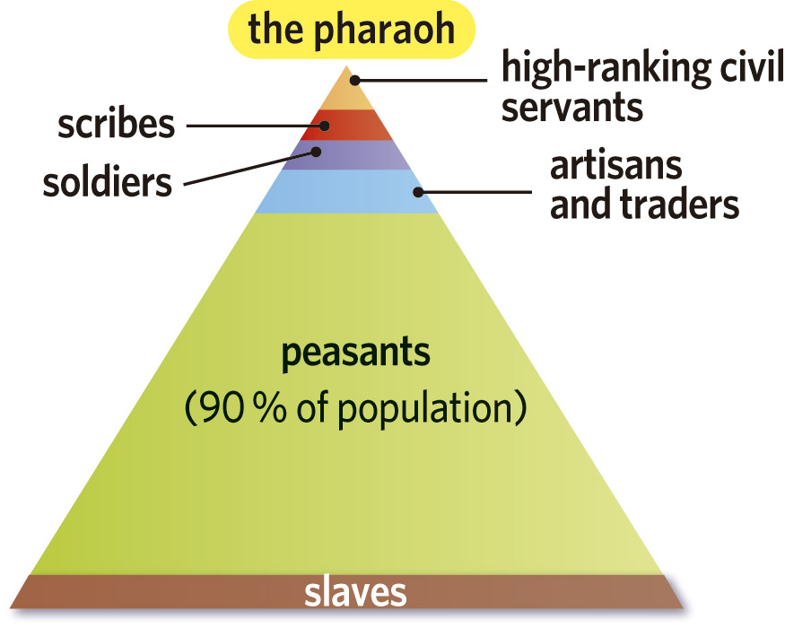
Freedom & Agency
How free do the people of your world feel?
Is there a caste system in place?
Does the whole (known) world follow the same system?
Do the people know of different systems?
Are they fighting for a change?

Slide 32
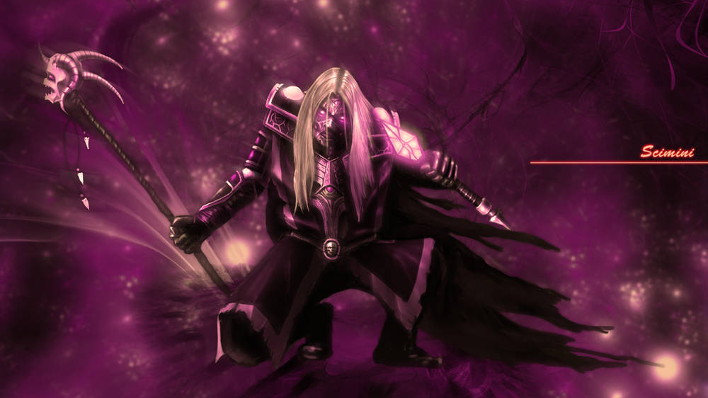
Power!
Wealth
How is personal wealth created?
Can magic create wealth?
Religion
How organized is religion?
How directly do the Gods take a hand in the world
How “real” is the translation between the Gods and their followers?
Status
How does one gain or lose status?
Are there guilds in your world? What do the guilds control?

Slide 33
Additional Resources
30 Days of Worldbuilding:
http://www.web-writer.net/fantasy/days/
Reddit forum on Worldbuilding
https://www.reddit.com/r/worldbuilding/
Climate Classifications
https://vividmaps.com/climate-classification-systems/
Religion Creation Primer
https://inkwellideas.com/worldbuilding/worldbuilding-religion-design/
Animal Niches (for filling up the fauna of your world)
https://www.reddit.com/r/SpeculativeEvolution/comments/9mxk9c/a_list_i_compiled_of_common_animal_niches/
People in the Medieval world
https://medium.com/migration-issues/notes-on-medieval-population-geography-fd062449364f

Slide 34
Map Generators
Island/Volcanic Map:
https://www.redblobgames.com/maps/mapgen2/
Fantasy City Map:
https://watabou.itch.io/medieval-fantasy-city-generator
Map Painter
https://www.redblobgames.com/maps/mapgen4/
City Painter
http://citypainter.watabou.ru/
Nerd all the way out: https://docs.google.com/document/d/1TKoyrApuKeynNIh_hYUPXMXgFUaS3LJ3USLS0s9HrB0/edit

Slide 35
Online Play

Slide 36
D&D Beyond

Slide 37
Kobold Fight Club

Slide 38
Roll20

Slide 39
Token Maker

Slide 40
Google Images

Slide 41
Lost Atlas lostatlas.co

